Slide 1
IOT PROJECT IDEA’S By: Ritwik M(18101c2020) Chaitanya D(18101C2021) Siddharth.P(18101c2016)

Slide 2
Projects Shortlisted
SMART DOOR BELL
SMART SHOES
SMART CAP

Slide 3
1.SMART DOOR BELL
About this Project:
We wanted to make a system that would alert me on my phone whenever someone rings the door bell. We often miss the doorbell of some reason or another.
Using this system you will never miss anyone who knocks on your door.
Using an Arduino and an ethernet shield to connect the button to the internet, the system using an app to connect it to the cloud. The system sends a mobile notification whenever the door bell it is pressed.
The persons image will also be captured using the camera & saved in the database

Slide 4
Components Used:
NodeMcu
Single Relay
Camera
Wifi +Server
Conclusion:
Thus we can efficiently manage this real-time system easily using the required components.

Slide 5
2 . SMART SHOES
About this project:
Auto lacing helps children who don't know how to lace and old people who have back problem. -Step counting helps runners and joggers.
It will be monitored via an app which will be counting the steps no.of kms walked etc.
Components Used:
Particle Photon *2
Stepper Motor
IR Sensor
Temperature Sensor
Wifi + Server
Conclusion:
Thus we can easily manage footcount,kms walked,using a well designed app

Slide 6
3 . SMART CAP
About This Project:
Good vision is a precious gift but unfortunately loss of vision is becoming common now-a-days. Smart cap can help with navigation. Navigation is one of them. And the solution is the Smart Cap - it helps with navigation
Components Used:
Arduino x1 (I had used the Uno Pro Mini as recommended)
Ultrasonic sensor x3
Mobile phone vibrator x2
Small Buzzer x1
Power source for the Arduino

Slide 7
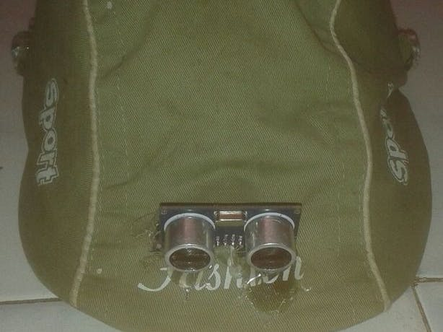
Conclusion:
The only drawback of the cap is that it can sense the objects only at the height range of the sensors.

Slide 8
THANK YOU

